Slide 1
IODVS
Intra-Operation Dynamic Voltage Scaling

Slide 2
Agenda
Who
What
Why
How
Results
Implications

Slide 3
About Me
ADMMicro / Gridpoint
Energy Management / Building Automation
Sub-metering building loads (HVAC / Lighting / etc.)
Environmental / Lighting Control
Communicating thermostats / remote sensors
Elster
Utility Metering (Gas / Water / Electricity)
Measurement accuracy and data integrity are key!
Communication via 900MHz Mesh / 2.4GHz Zigbee / 2G/3G
NCSU
Working with Dr. Dean on low-power embedded systems
Mitigating performance loss due to power requirements … or at least quantifying them

Slide 4
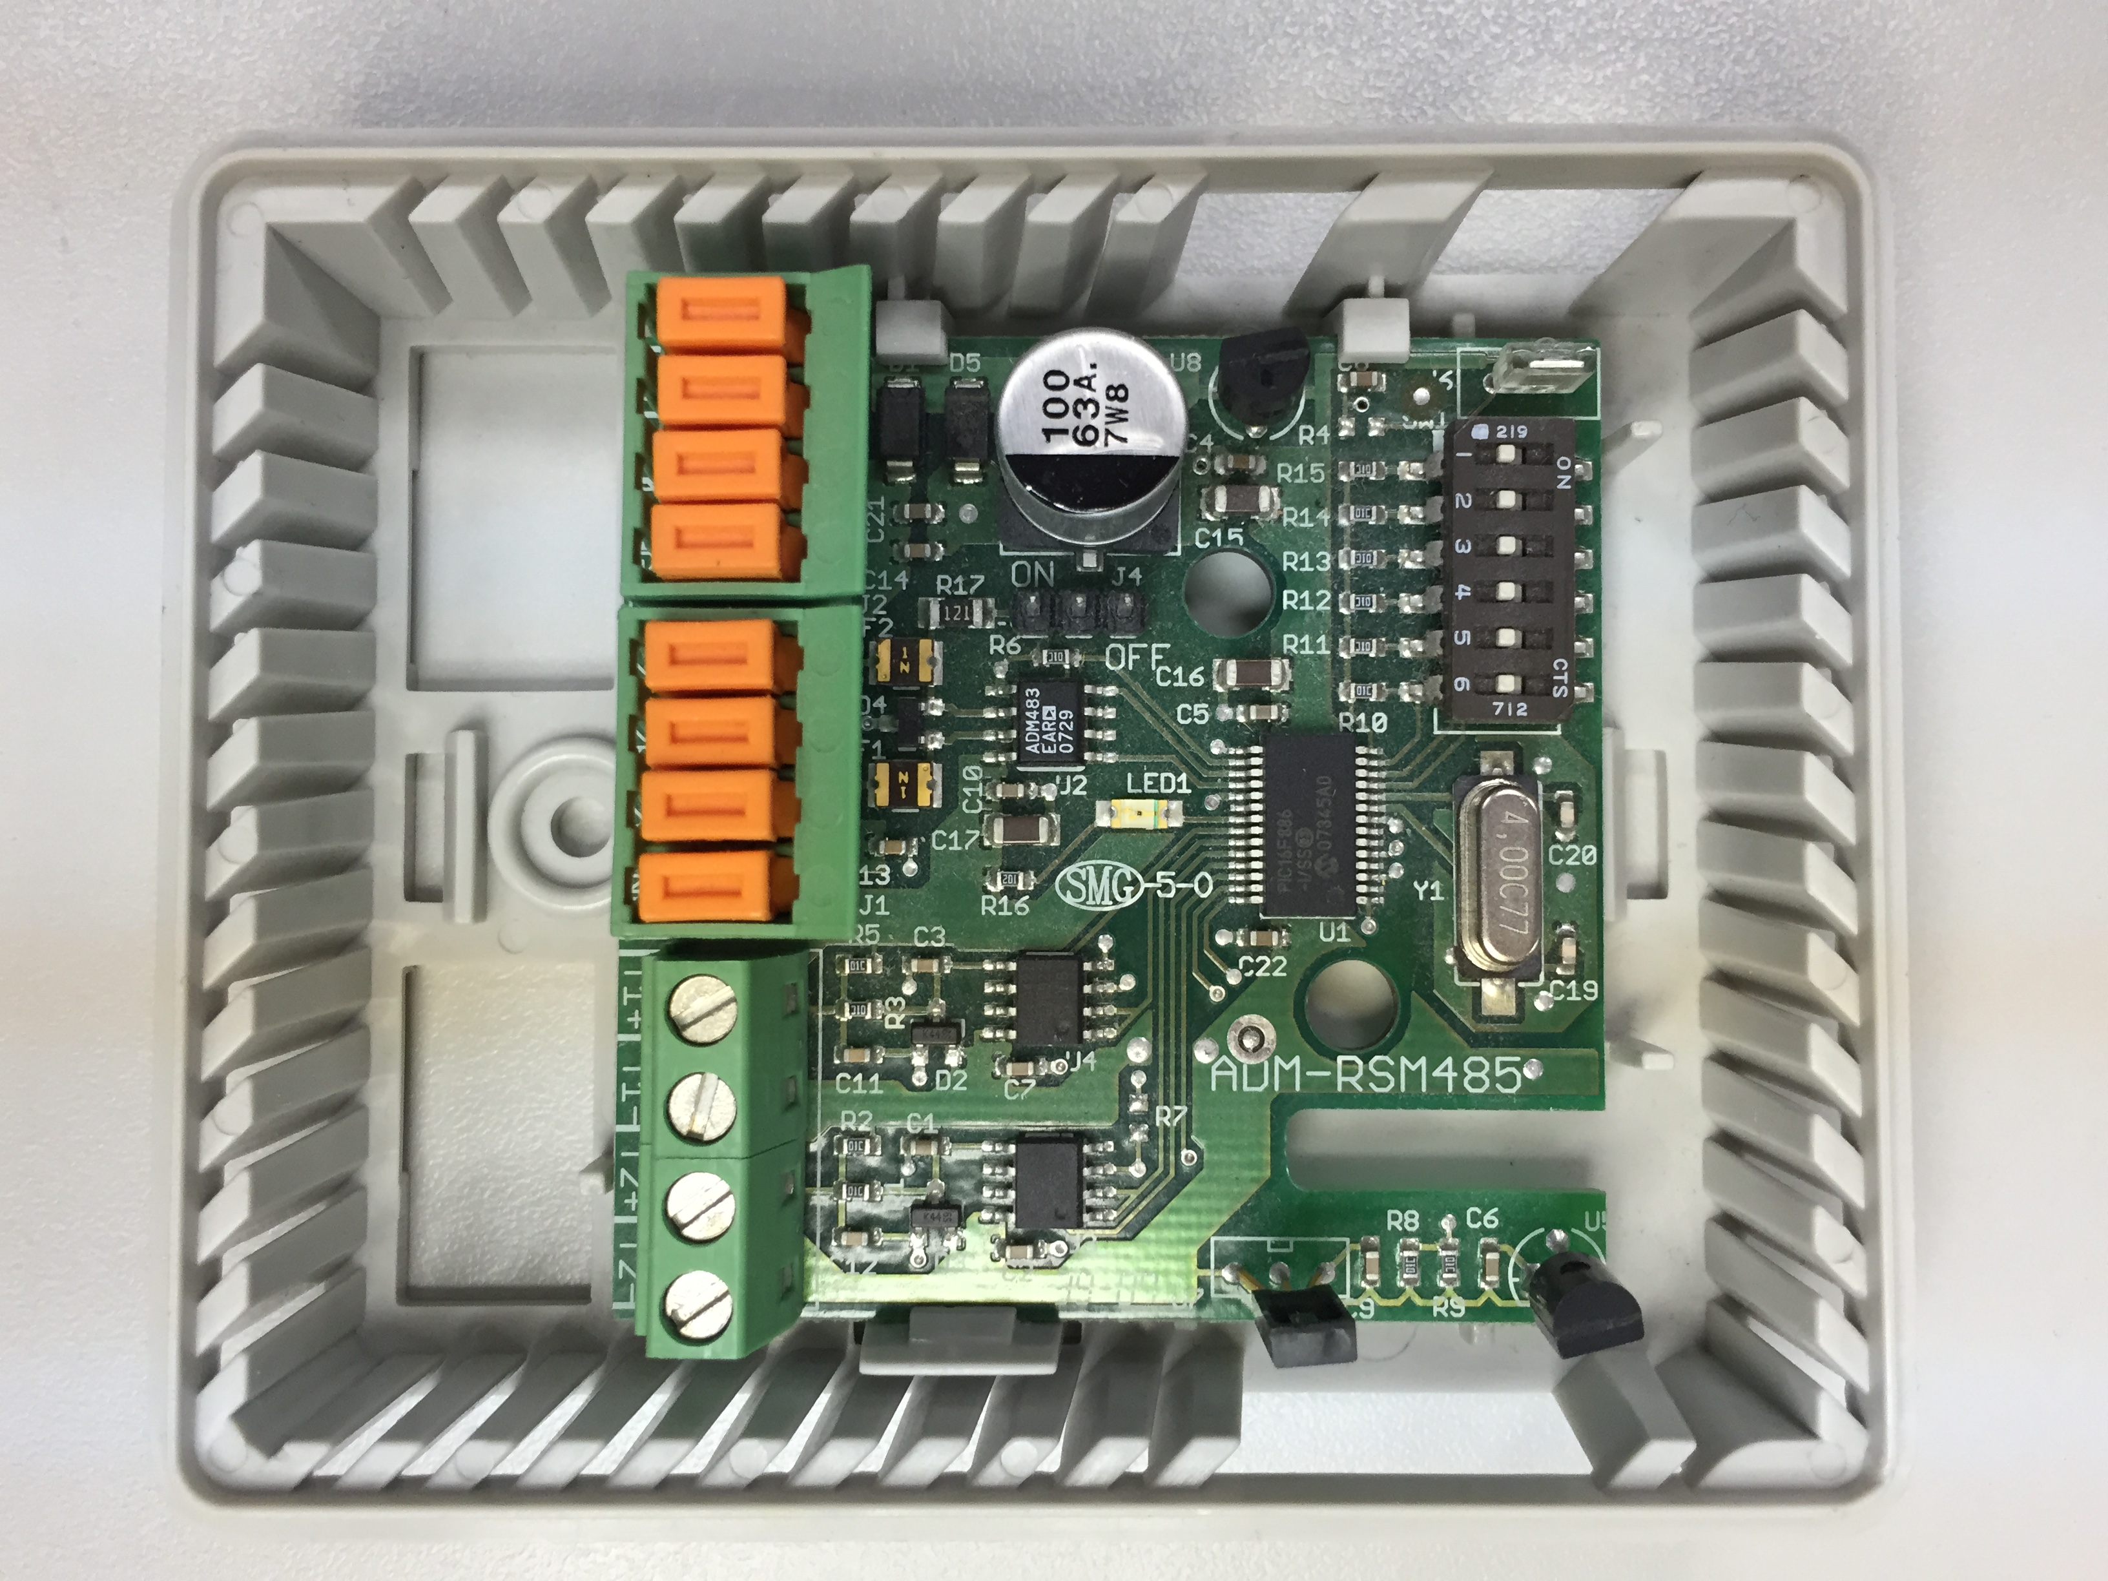
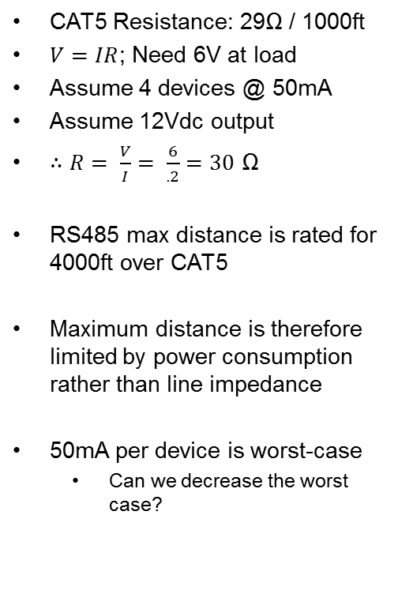
Motivating Example: Remote Sensor Module
CAT5 Resistance: 29Ω / 1000ft
$V=IR$; Need 6V at load
Assume 4 devices @ 50mA
Assume 12Vdc output
$∴R= \frac{V}{I}= \frac{6}{.2}=30$ Ω
RS485 max distance is rated for 4000ft over CAT5
Maximum distance is therefore limited by power consumption rather than line impedance
50mA per device is worst-case
Can we decrease the worst case?

Slide 5
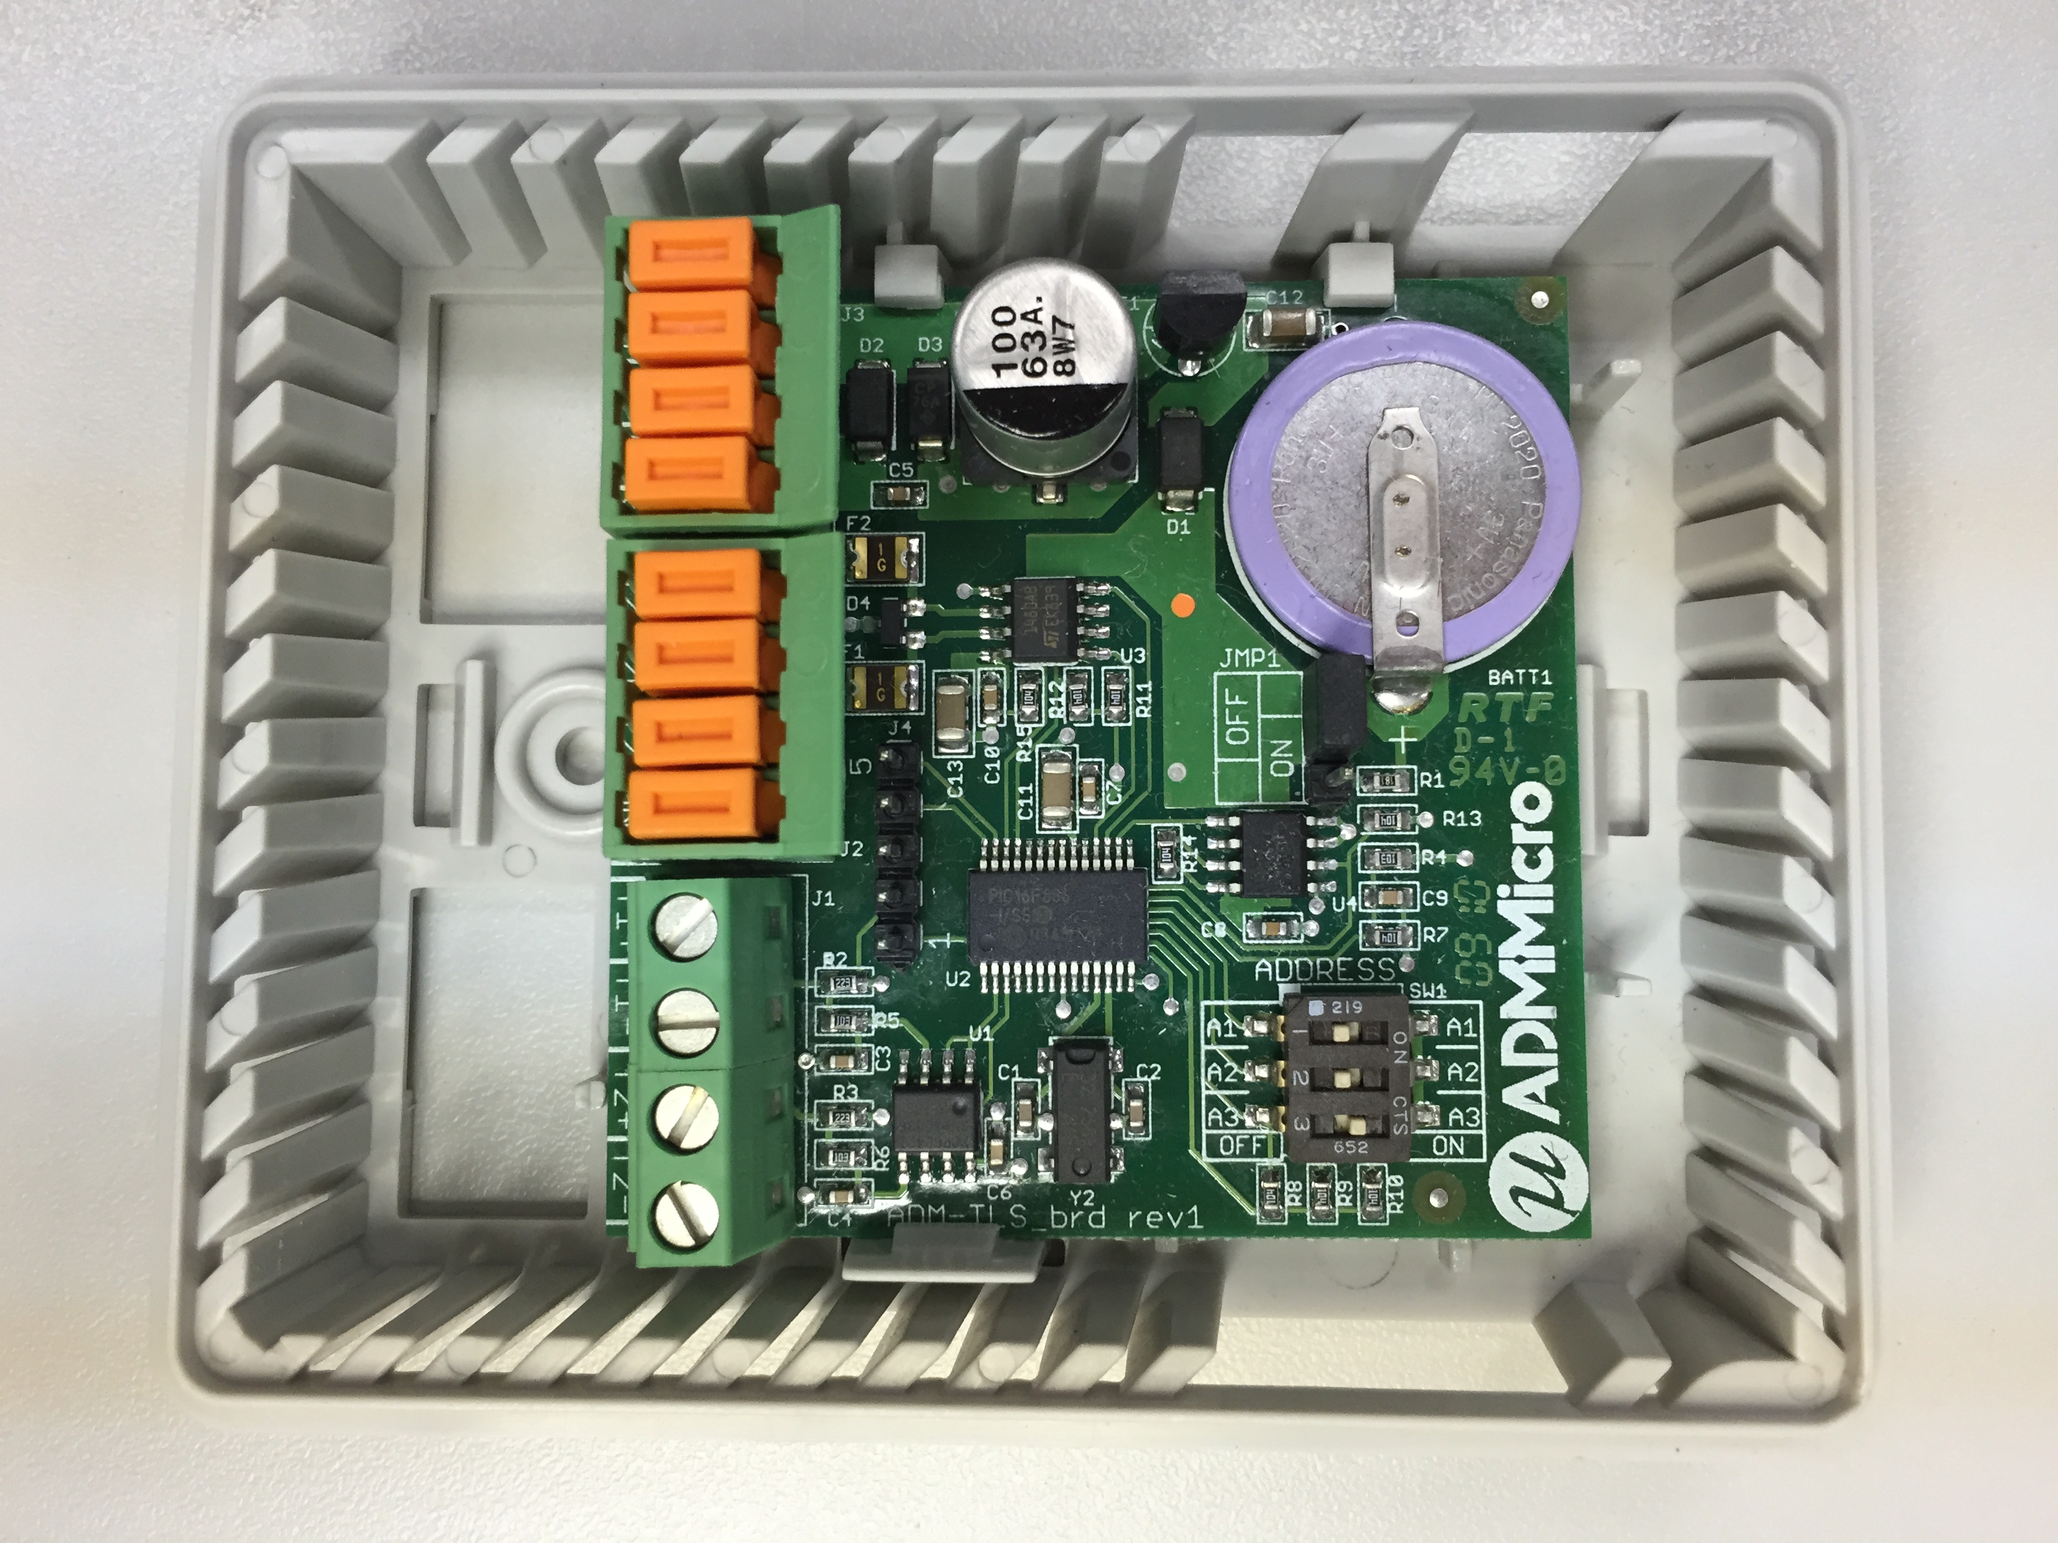
Motivating Example: Logging Sensor

Slide 6
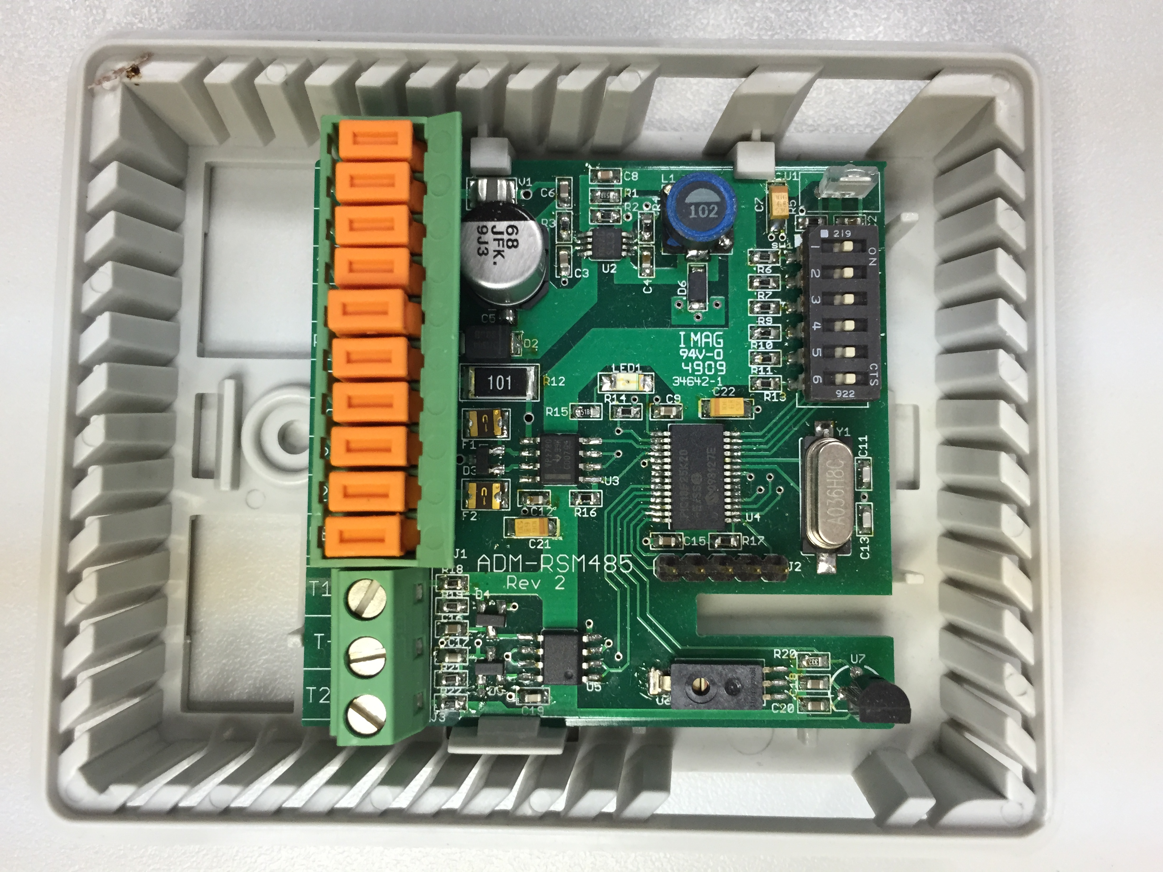
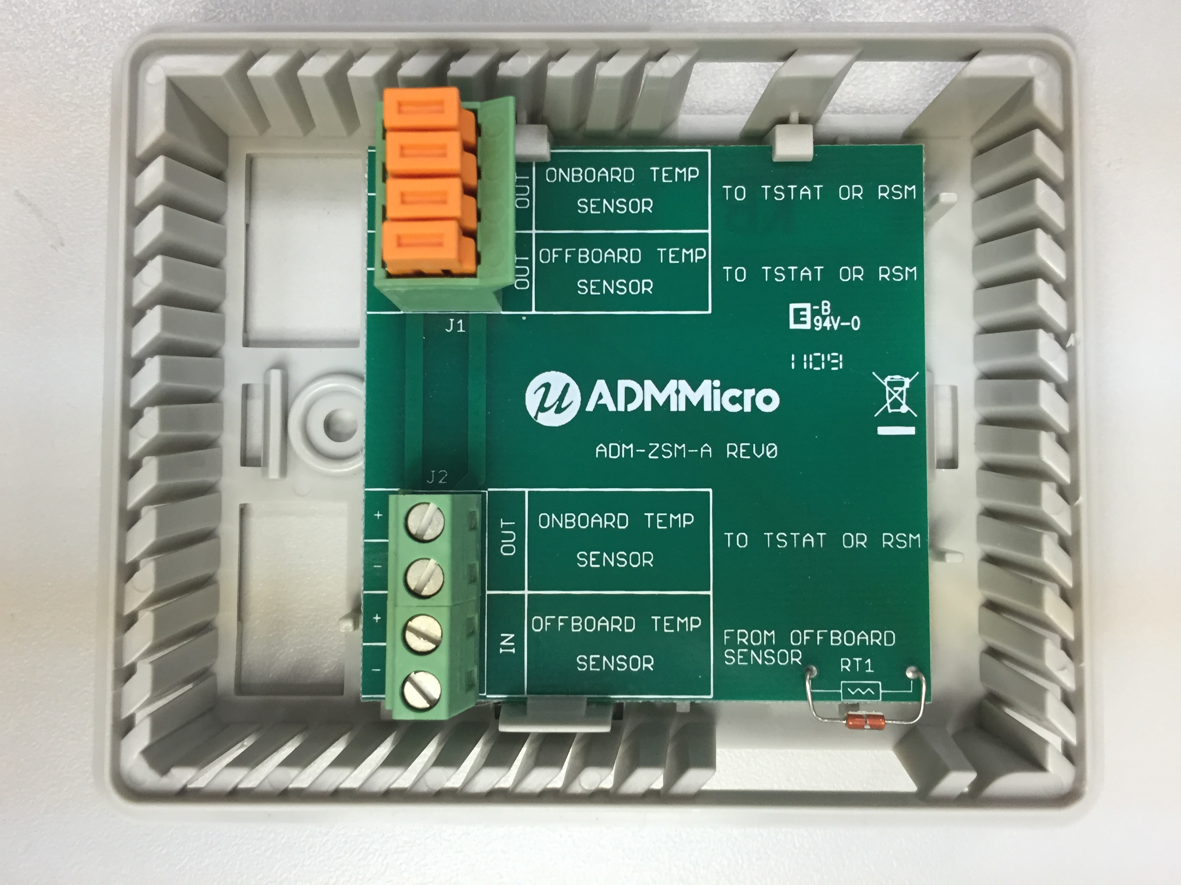
Remote Sensor Module V2
Zone Sensor Module

Slide 7
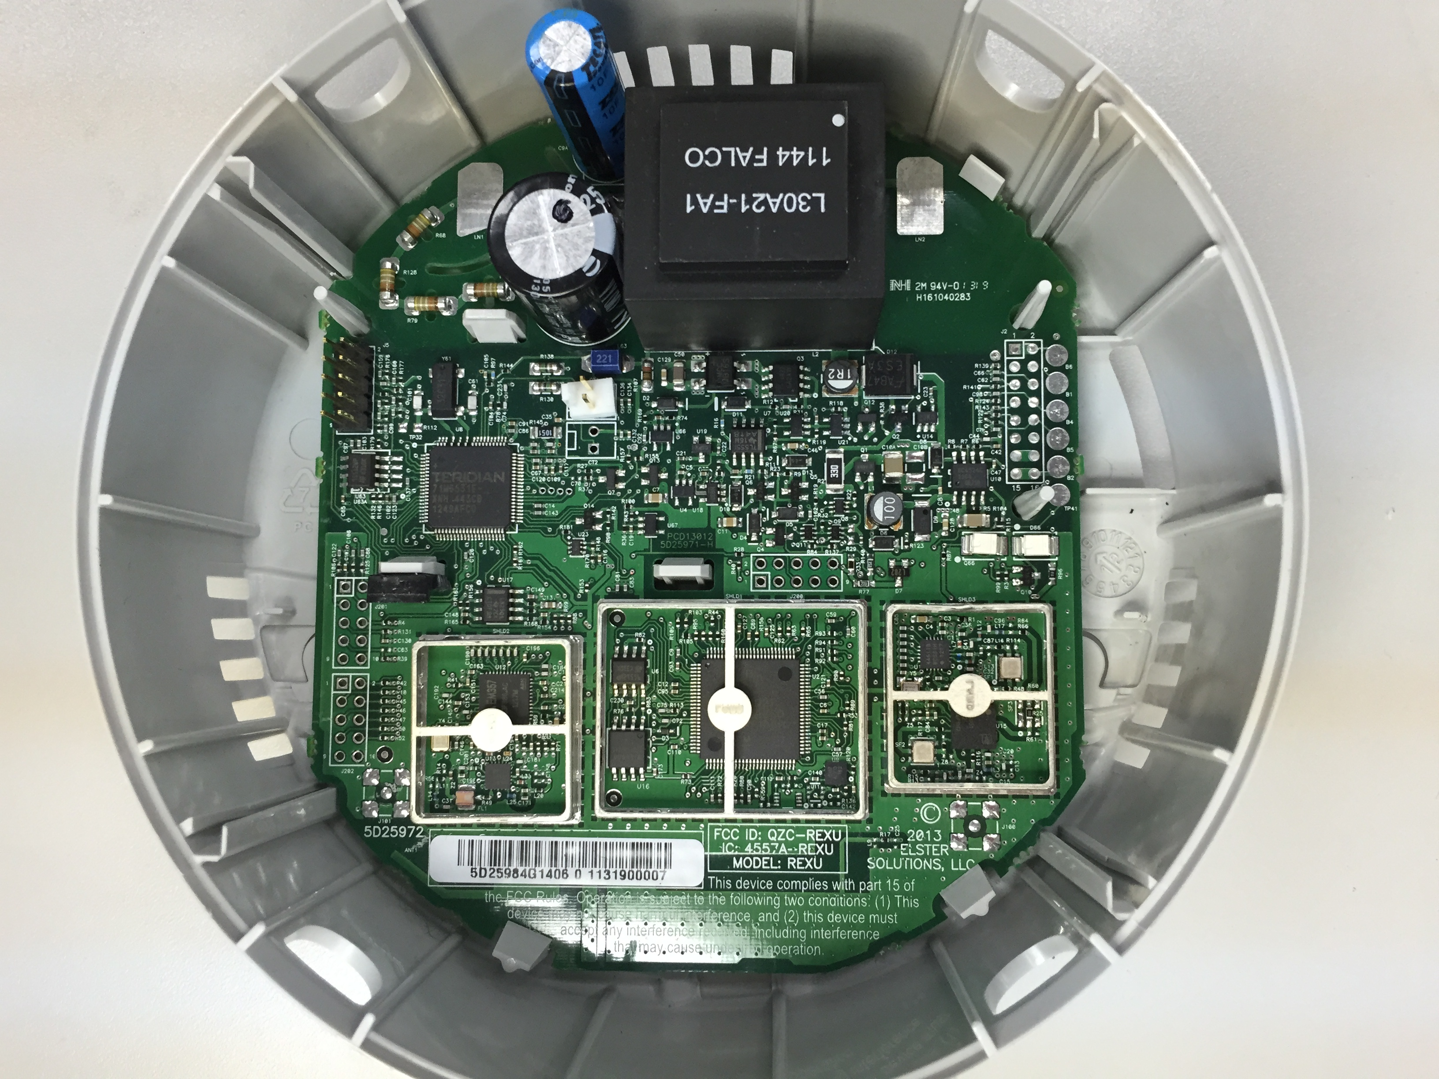
Motivating Example: Rex Electricity Meter
Maxim 8051 Metrology Core
Uses EEPROM
Energy Usage
Demand Intervals
Profile Information
NV-RAM
TI Cortex-M3 Core
Uses Serial flash
Network routing data
Encryption Keys?
Radio Interface
Ember Zigbee
Radio Interface

Slide 8
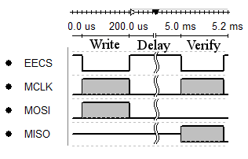
NV-RAM Functionality
EEPROM has a limited write-cycle count (~1,000,000)
Serial flash is typically ~100,000
Some values need to be updated constantly and preserved across power failures
Typically indexes into logs
Energy accumulations
Status information
Solution: Use RAM, and use an interrupt to back it up as power fail occurs
Requires a capacitor capable of holding Vdd while backup is in progress
Actual communication is only 7.7% of the total write time. The other 92.3% is a mandatory wait period imposed by the chip ‘page-write time’
How can we decrease the energy consumed during the page write time?

Slide 9
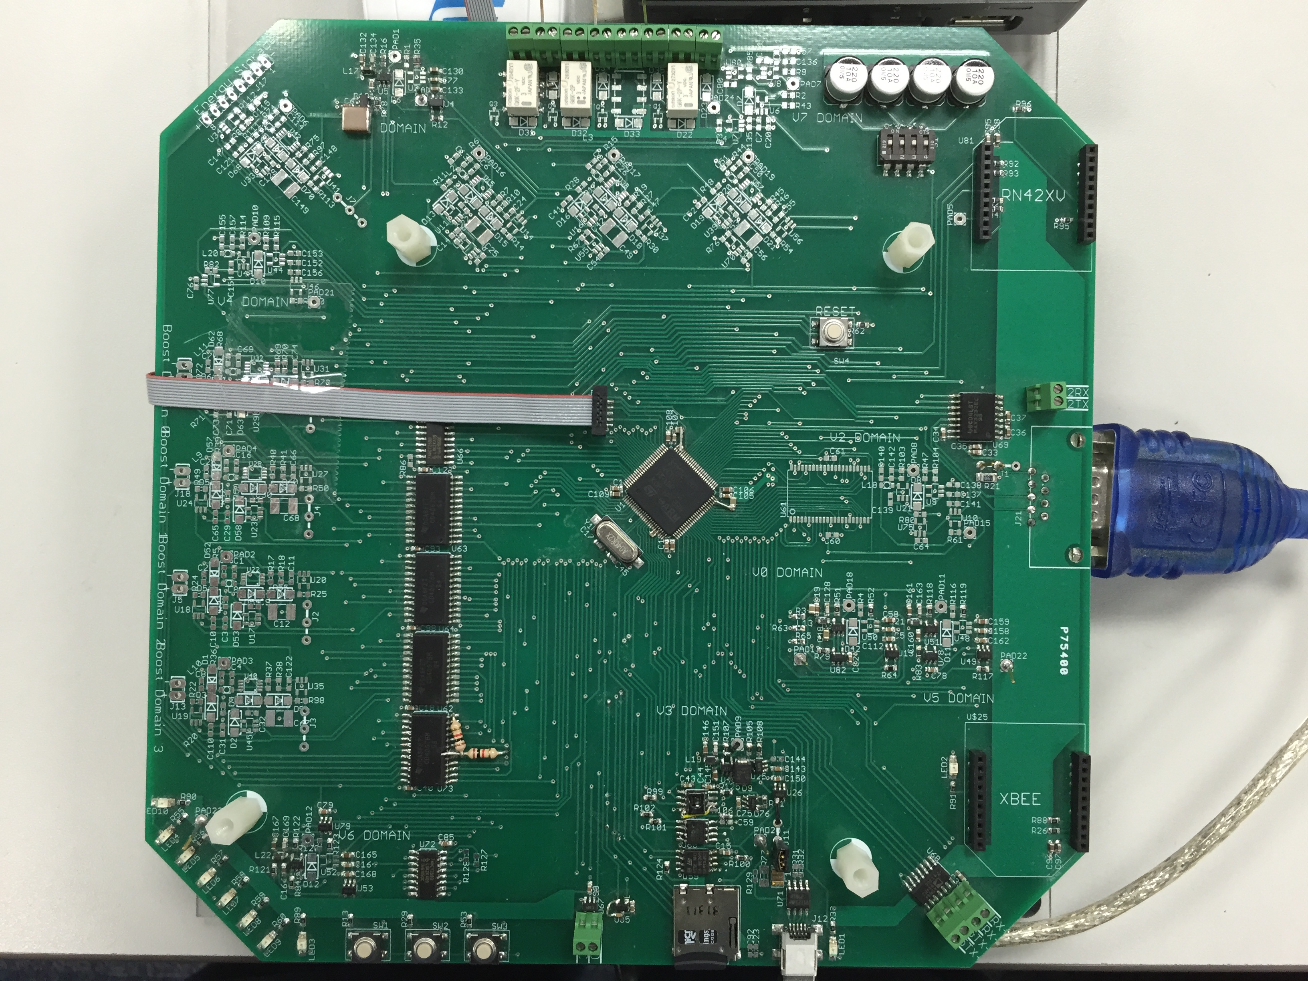
How: PEGMA
Peripheral Energy Generation Measurement and Allocation
4x + 1 input (boost) SMPS
3x output boost SMPS
8 independently adjustable buck SMPS domains
MCU: STM32F205
2x 10-bit DAC
3x 12-bit ADC (2 MSPS per)
Analog
SRAM
SPI Peripherals
EEPROM
Serial Flash
Temp/Humidity Sensor
Micro-SD Card
Battery Charging
Communications
LEDs / Pushbuttons
Relays
I/O Voltage and Current Measurement on each SMPS
Allows us to measure efficiency!

Slide 10
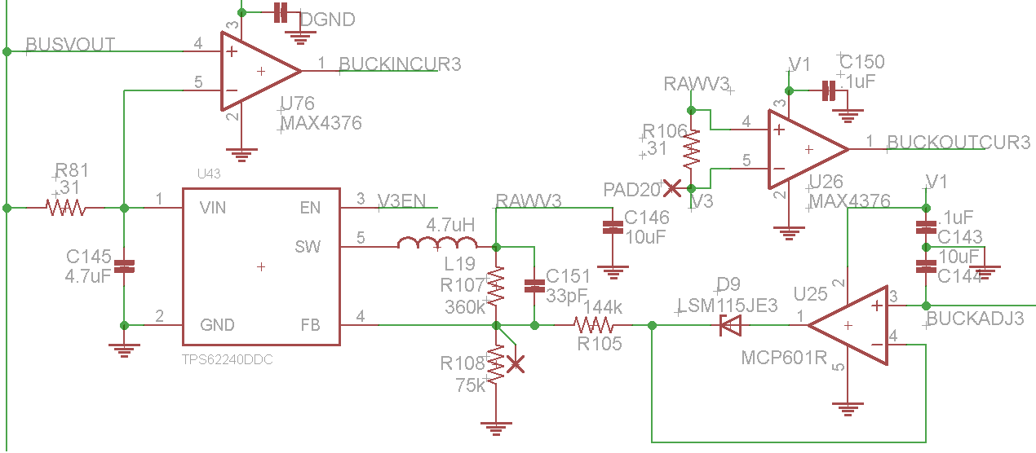
Adjustable SMPS
TPS62240 efficient at light loads
~80% at 1mA
I/O current measured by MAX4376
“High Side” sense resistor is used, differential across is multiplied by the amplifier gain
2MHz GBP, G = 20
Output Voltage modulated by current into the FB pin
Therefore D9 allows the SMPS to enter a ‘default’ state
And U25 / R105 allow FB current to be modulated by BUCKADJ3
C144 holds the adjustment voltage so that other domains can be ‘refreshed’ in round robin fashion

Slide 11
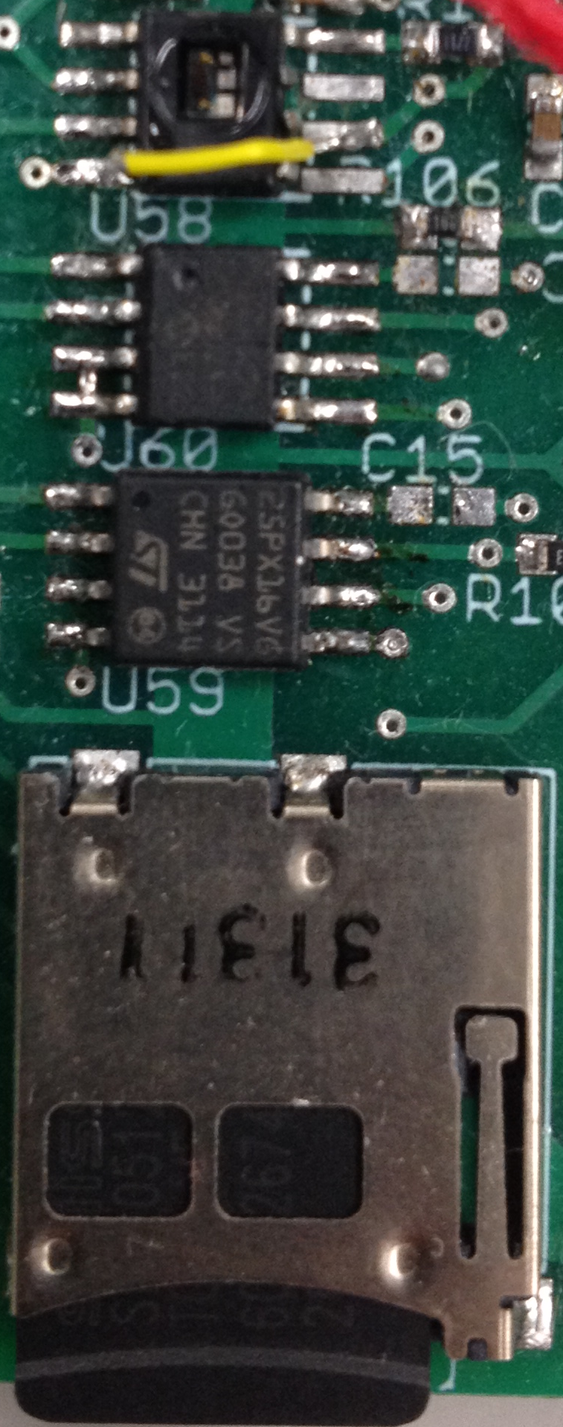
Peripheral Domain
Honeywell HIH6130 (I²C) Temperature/Humidity Sensor
Vmax: 5.5V
Vmin: 2.3V
Microchip 25AA512 EEPROM
Vmax: 5.5V
Vmin: 1.8V
Numonyx M25PX16 (16Mbit)
Vmax: 3.6V
Vmin: 2.3V
SPI Mode SD Cards
Lexar SDSC: 1.0GB
Sandisk: SDSC 1.0GB
Swissbit: SDSC 512MB
Kingston: SDSC 2.0GB
Vmax: 3.6V
Vmin: 2.7V (operating)
Vmin: 2.0V (Idle/Read)

Slide 12
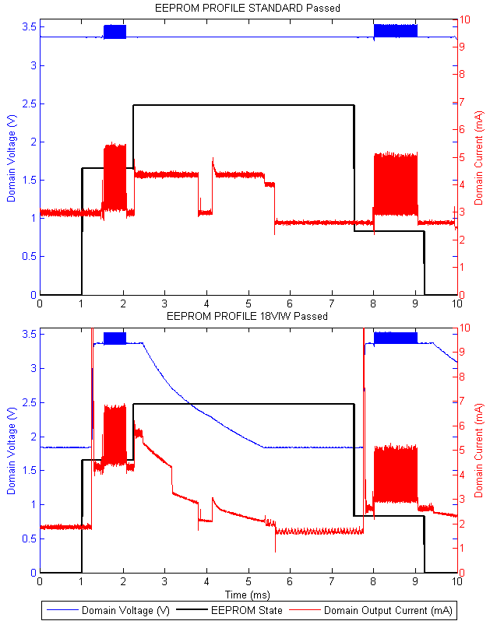
Microchip 25AA512 EEPROM
Hu
State | Static (uJ) | IODVS (uJ) | Delta
Idle | 10.24 | 3.49 | -65.91%
Write | 13.79 | 17.85 | 29.47%
Wait | 64.59 | 33.71 | -47.80%
Verify | 17.58 | 17.40 | -1.02%
Idle | 8.81 | 7.96 | -9.57%
Total | 115.02 | 80.43 | -30.07%

Slide 13
Numonyx 25PX16 Serial Flash
Hu
State | Static (uJ) | IODVS (uJ) | Delta
Idle | 10.73 | 5.63 | -47.58%
Read | 71.51 | 72.36 | 1.19%
Erase | 2.47 | 2.47 | -0.13%
Write* | 89.48 | 99.16 | 10.82%
Wait* | 574.84 | 365.75 | -36.37%
Verify | 83.78 | 52.77 | -37.02%
Idle | 38.92 | 38.20 | -1.85%
Total | 2666.18 | 1614.57 | -39.44%

Slide 14
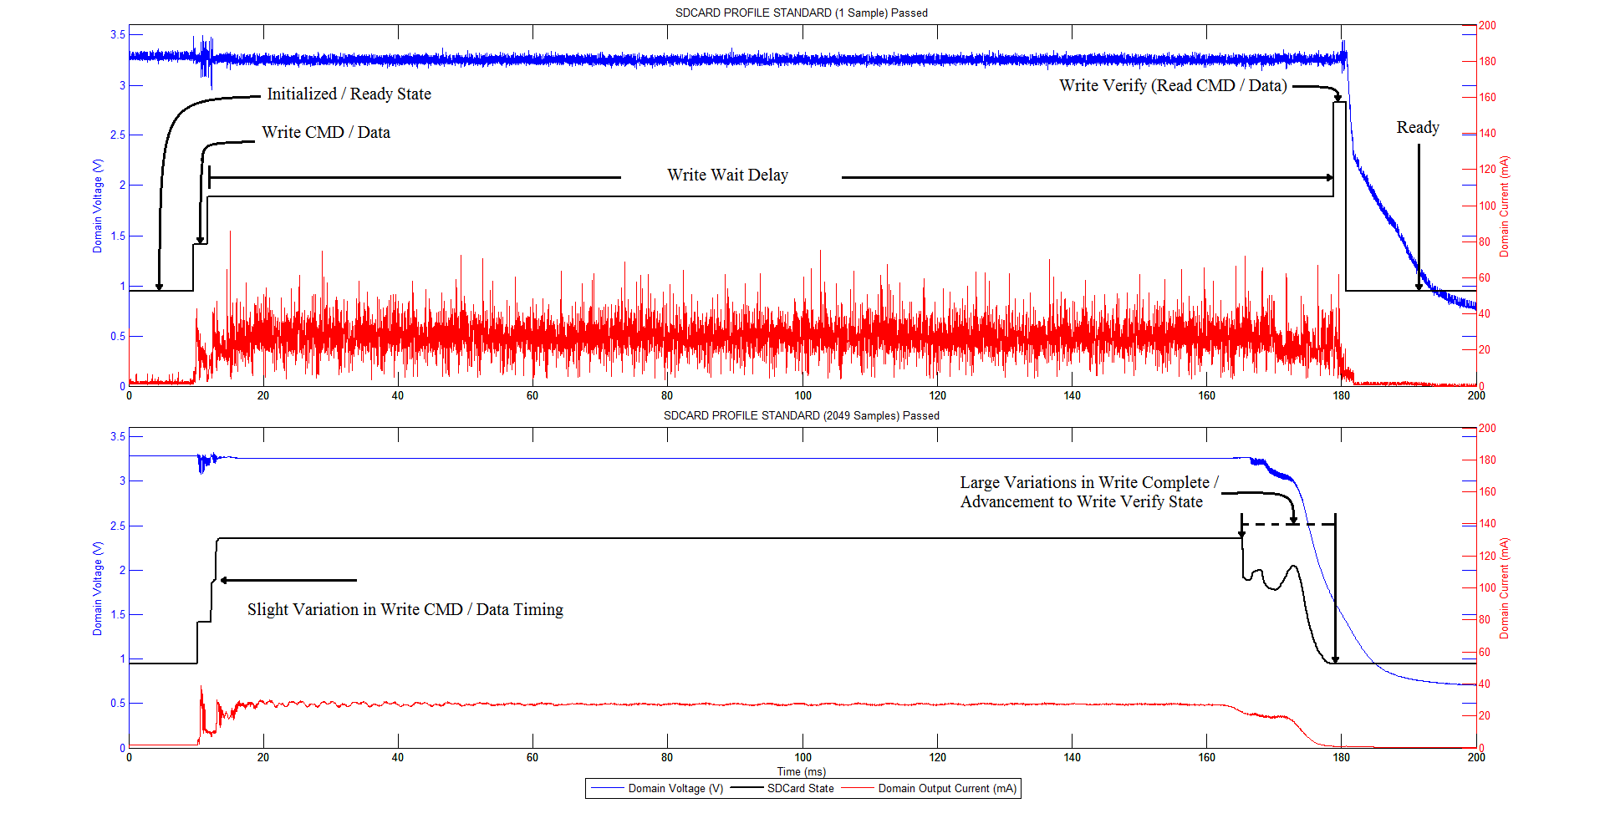
SD-Card Timing Variations
These tests tend to be non-deterministic

